Slide 1


Slide 2
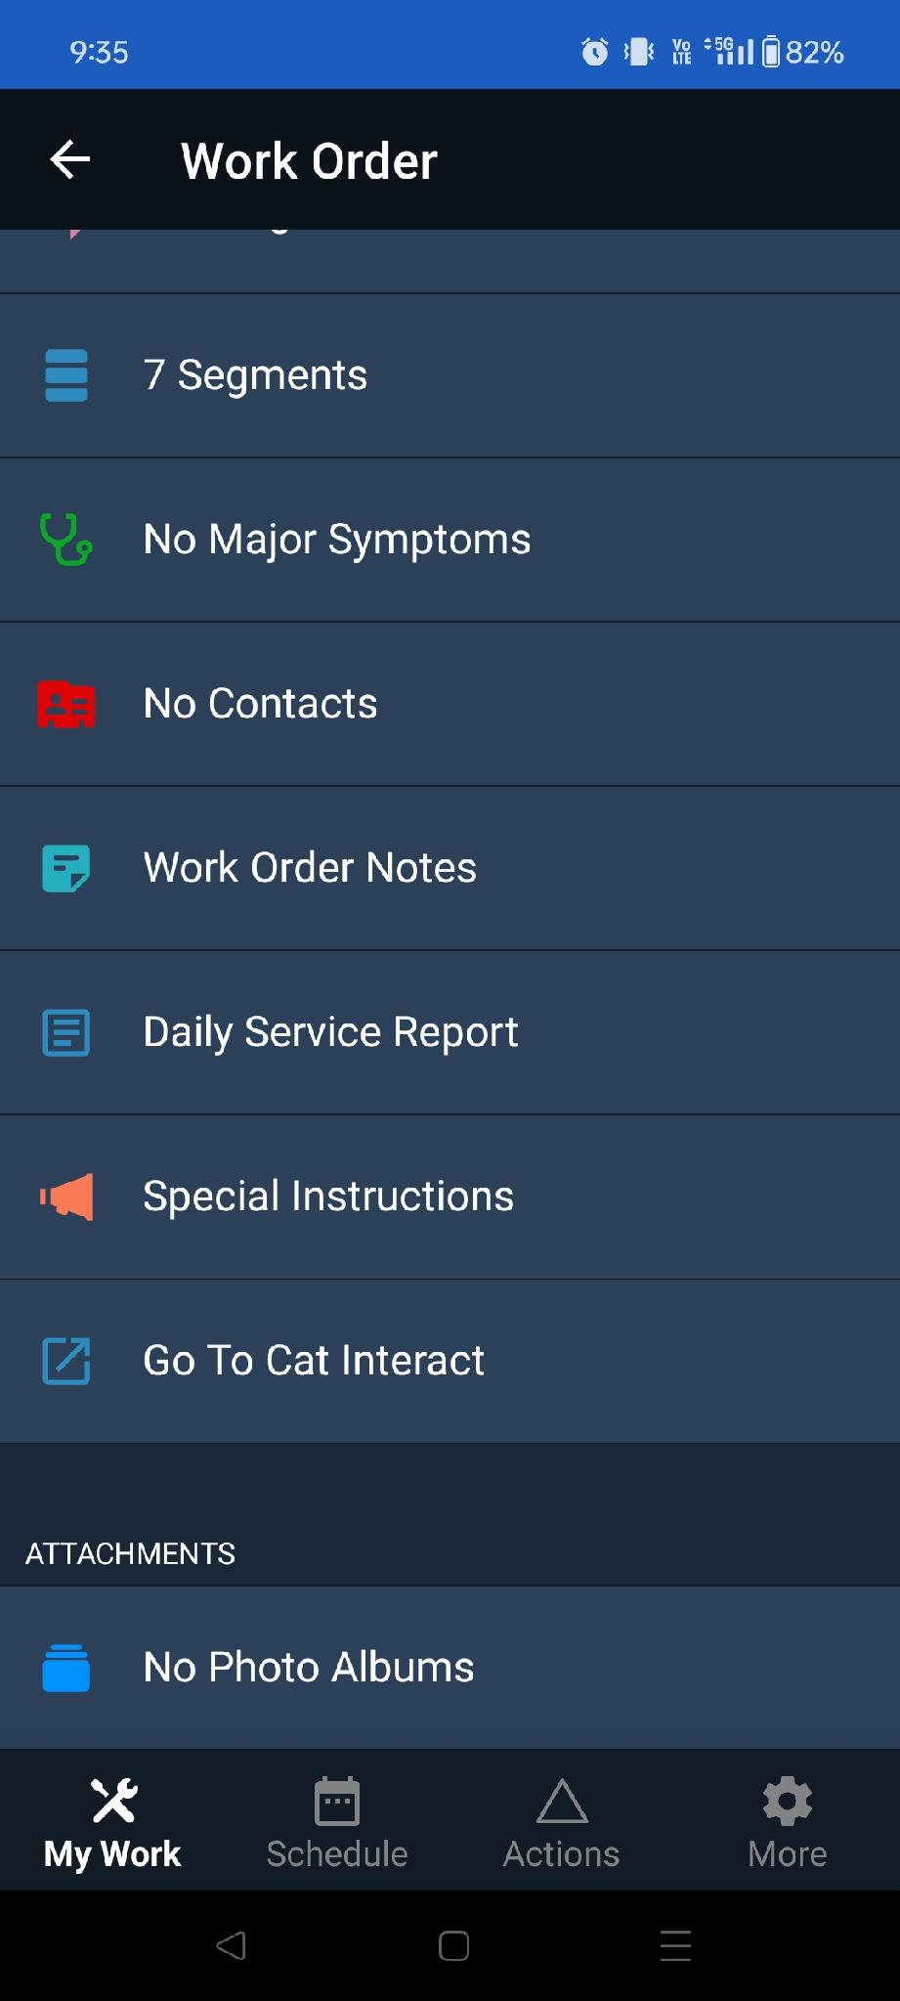

Slide 3
Go to enter a Service Report

Slide 4
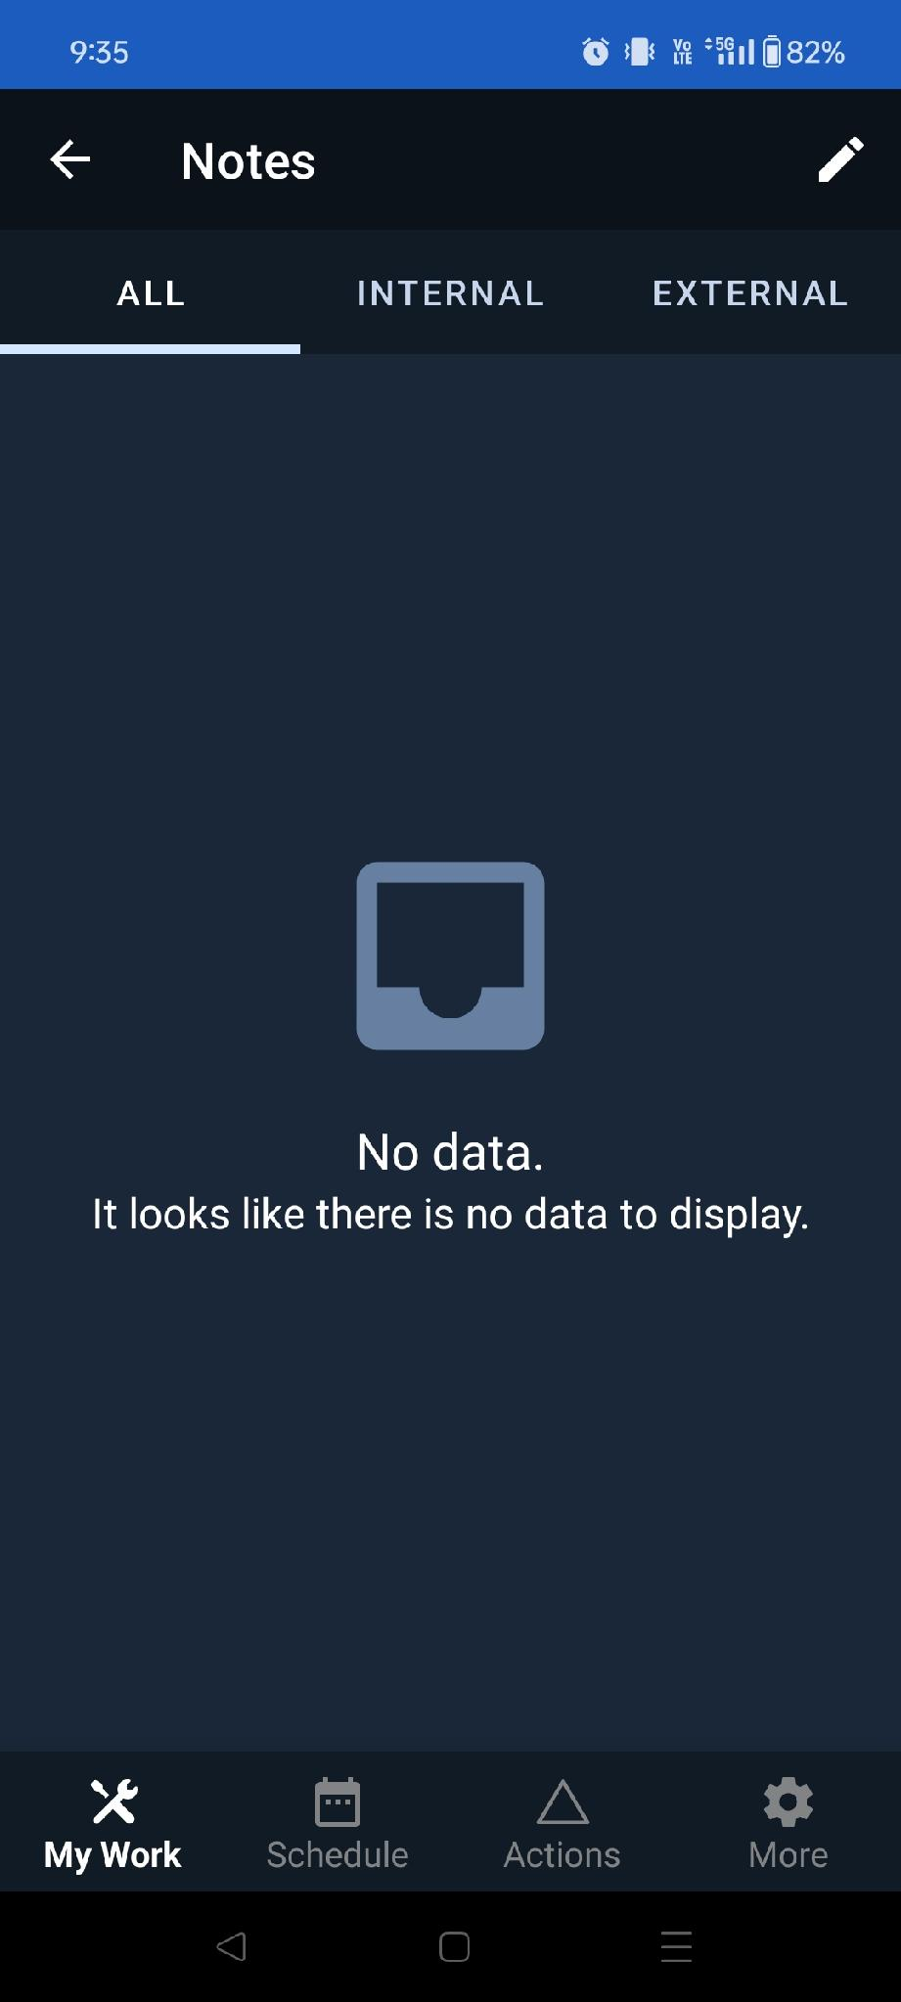

Slide 5
Add a new Service Report entry

Slide 6
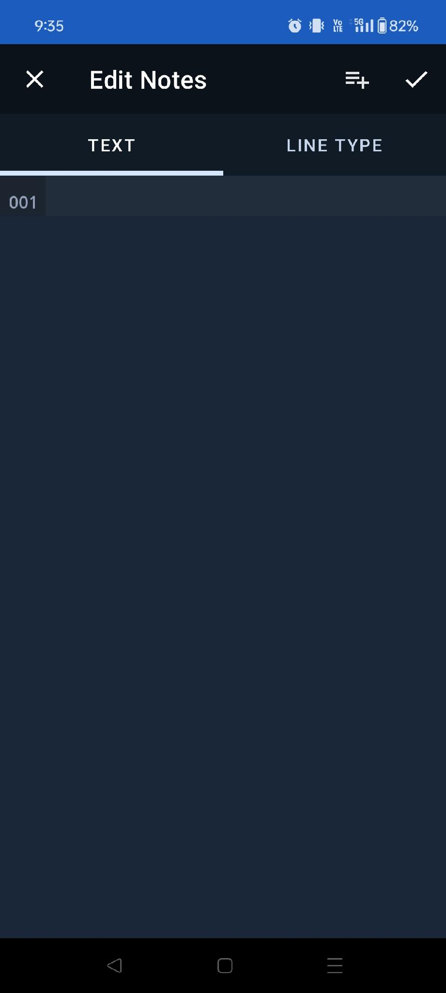

Slide 7
Tap anywhere to bring up the keyboard

Slide 8
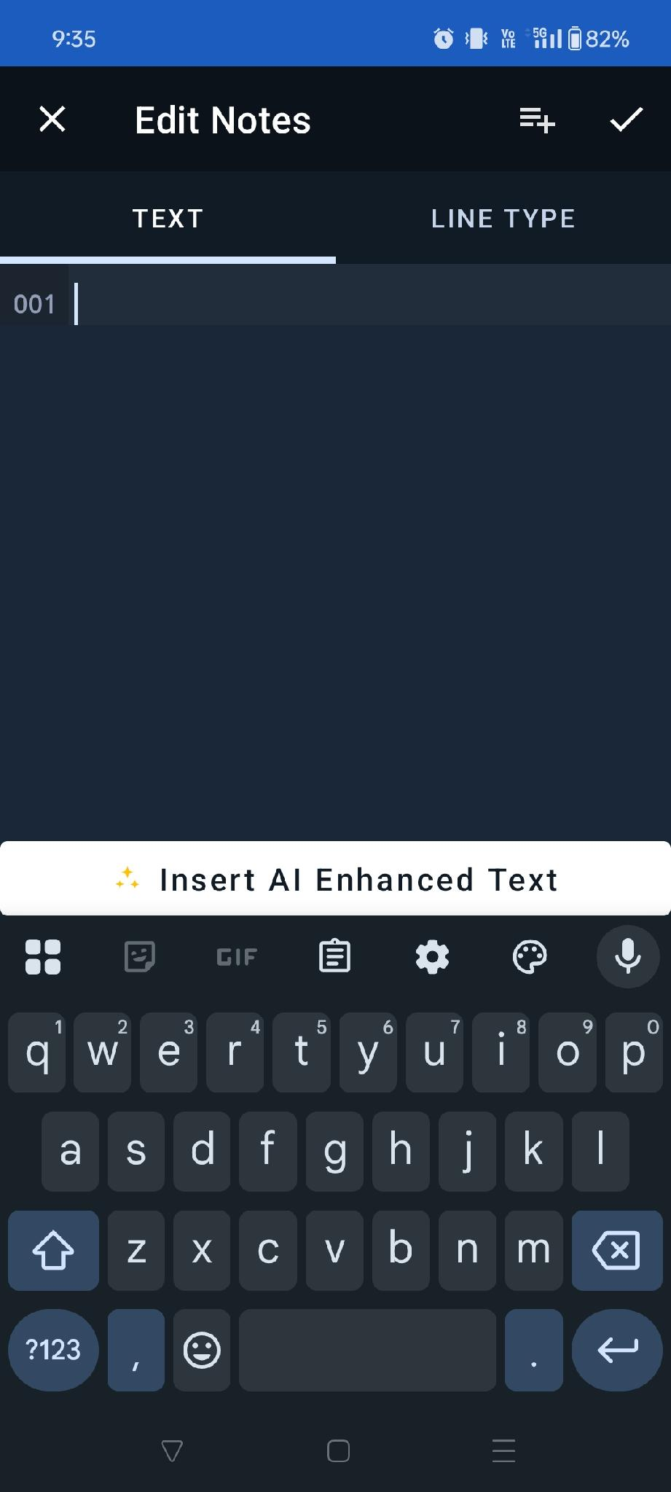

Slide 9
AI Enhancement Menu pops up

Slide 10
Tap on it to begin

Slide 11


Slide 12
Tap anywhere to bring up the keyboard

Slide 13
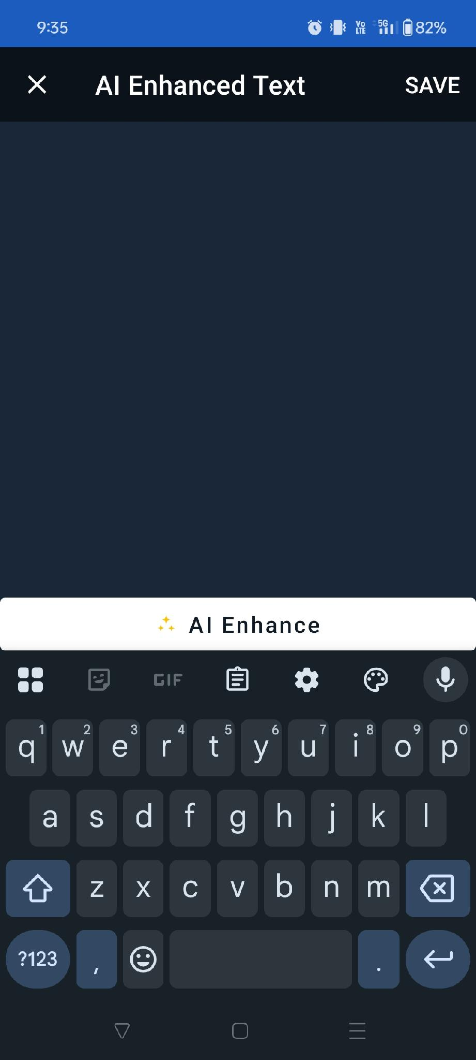

Slide 14
Type (or speak!) your Service Report into the window.

Slide 15
Let’s look at a few examples.

Slide 16
Example #1:
Distracted Technician

Slide 17
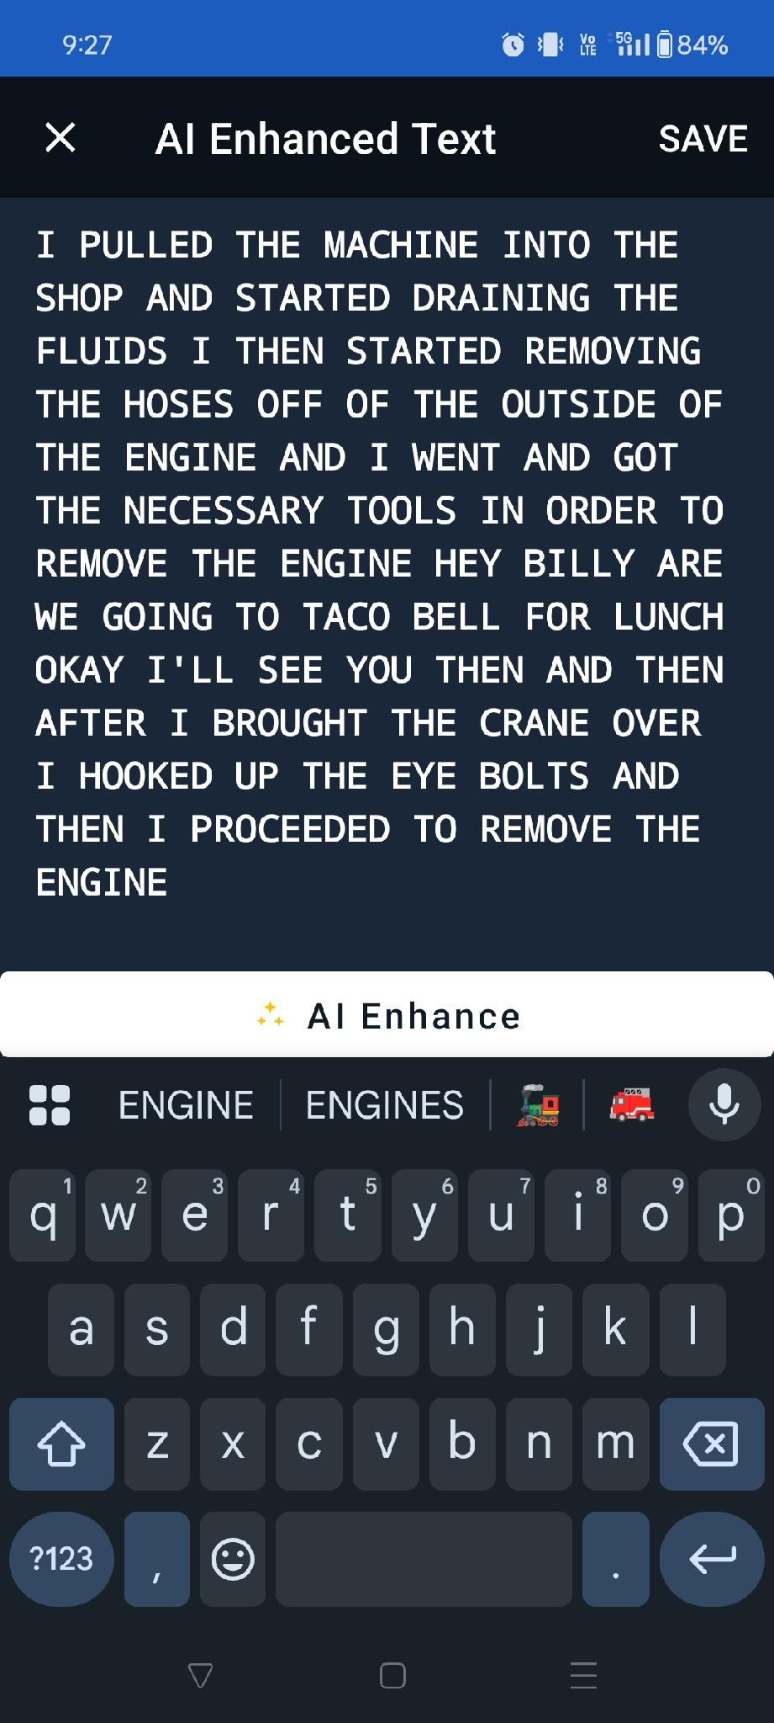

Slide 18
Tech 1 gets distracted by his friend with lunch plans, and the microphone picked it up.

Slide 19
Let’s hit the “AI Enhance” button and see how it cleans it up…

Slide 20
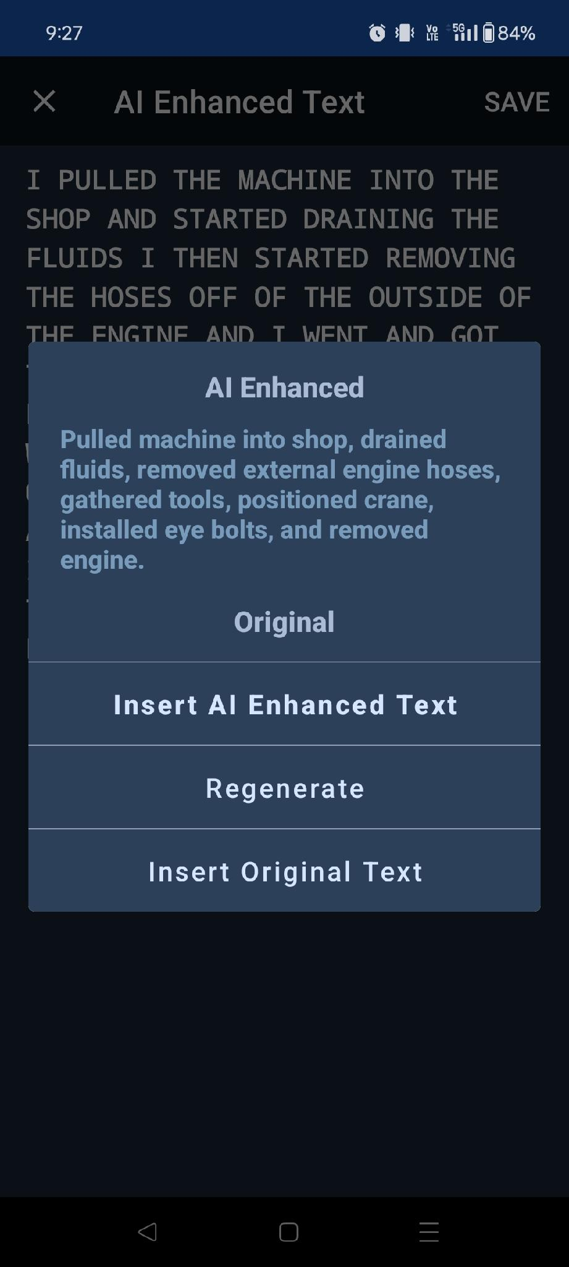

Slide 21
The irrelevant conversation is entirely erased, leaving only the repair details.

Slide 22
From here, we have a few options…

Slide 23
We can insert the updated AI Enhanced text.

Slide 24
We can regenerate the AI prompt for a different text enhancement.

Slide 25
Or we can use the original text.

Slide 26
Let’s look at another example.

Slide 27
Example #2:
Verbose Technician

Slide 28
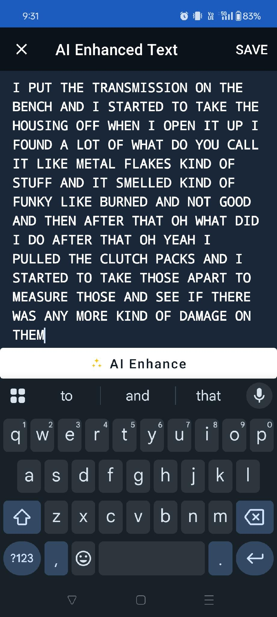

Slide 29
Tech 2 is long-winded and undescriptive. He also speaks to himself while monologuing.

Slide 30
Let’s see how the AI will enhance this Service Report.

Slide 31
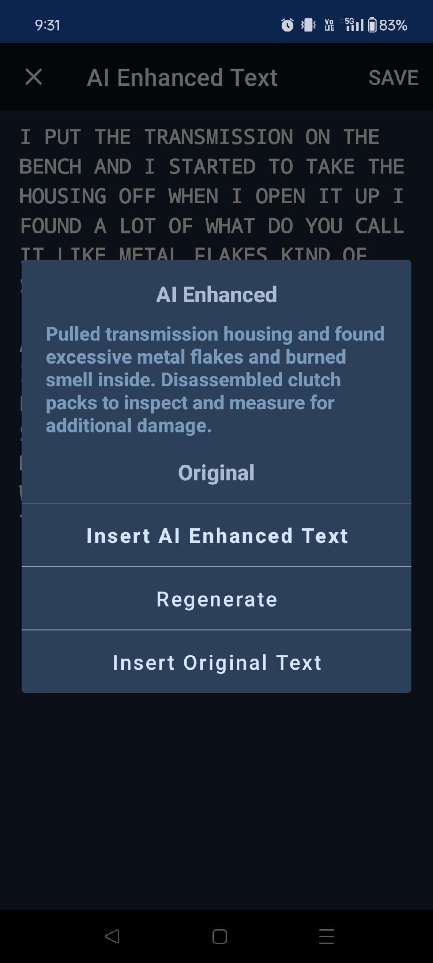

Slide 32
The AI has removed the long-winded description and any unnecessary text, leaving only pertinent details.

Slide 33
Let’s look at our final example.

Slide 34
Example #3:
Foul-Mouthed Technician

Slide 35
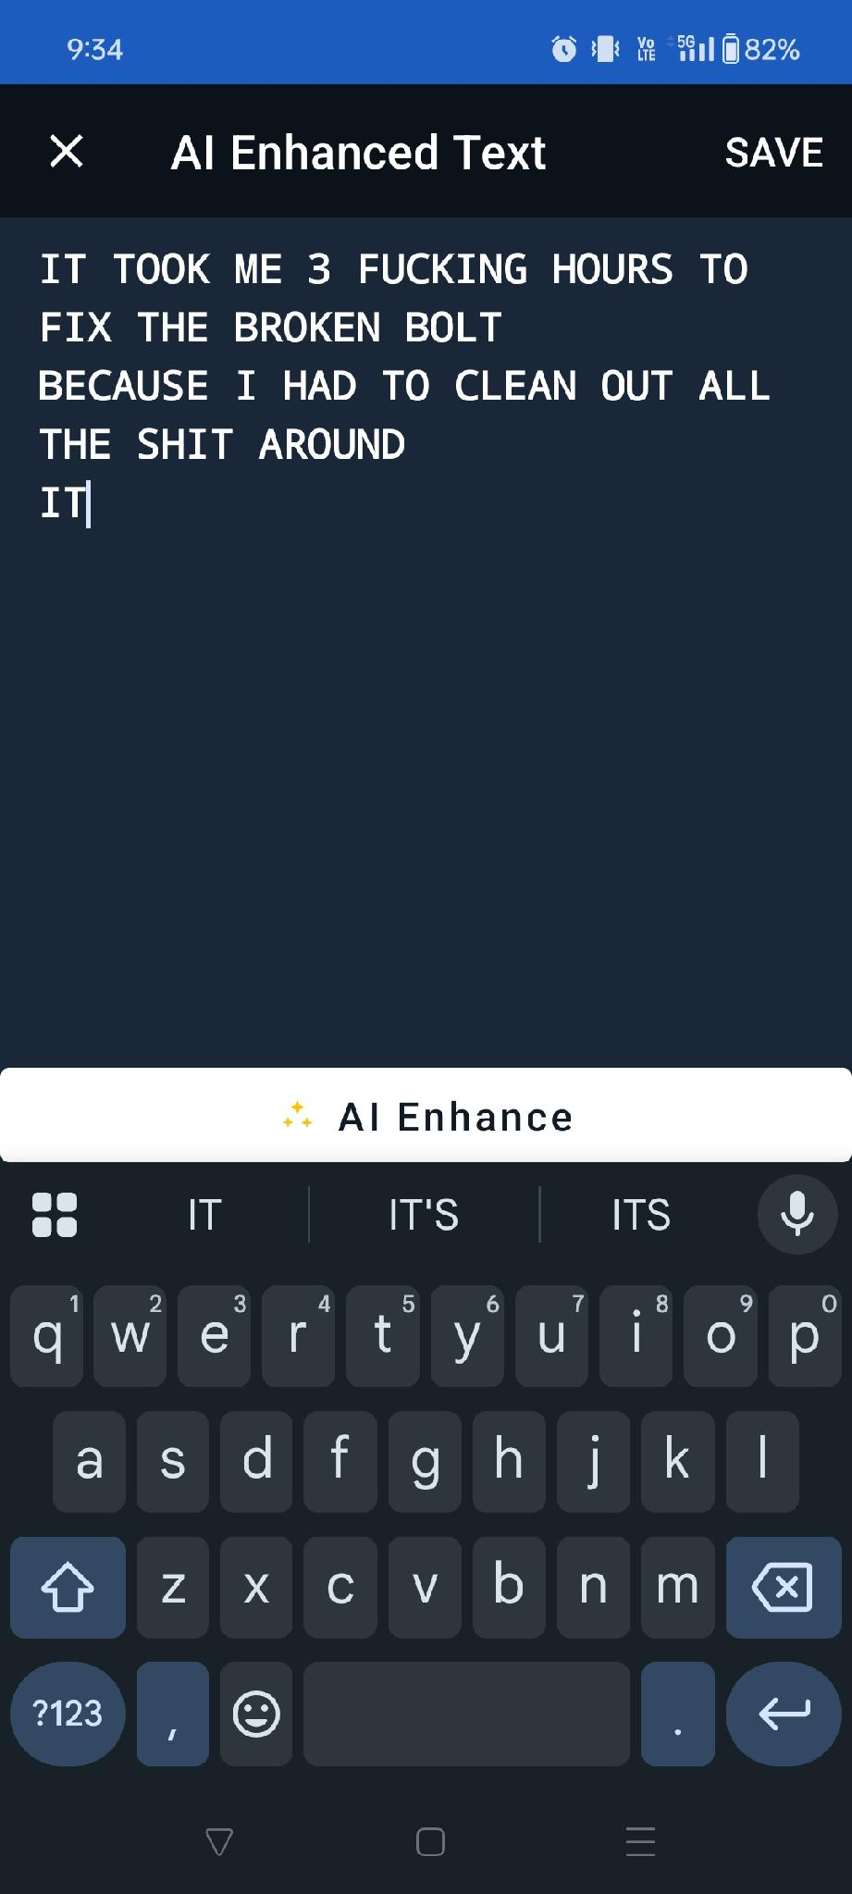


Slide 36
Let’s clean this up…

Slide 37
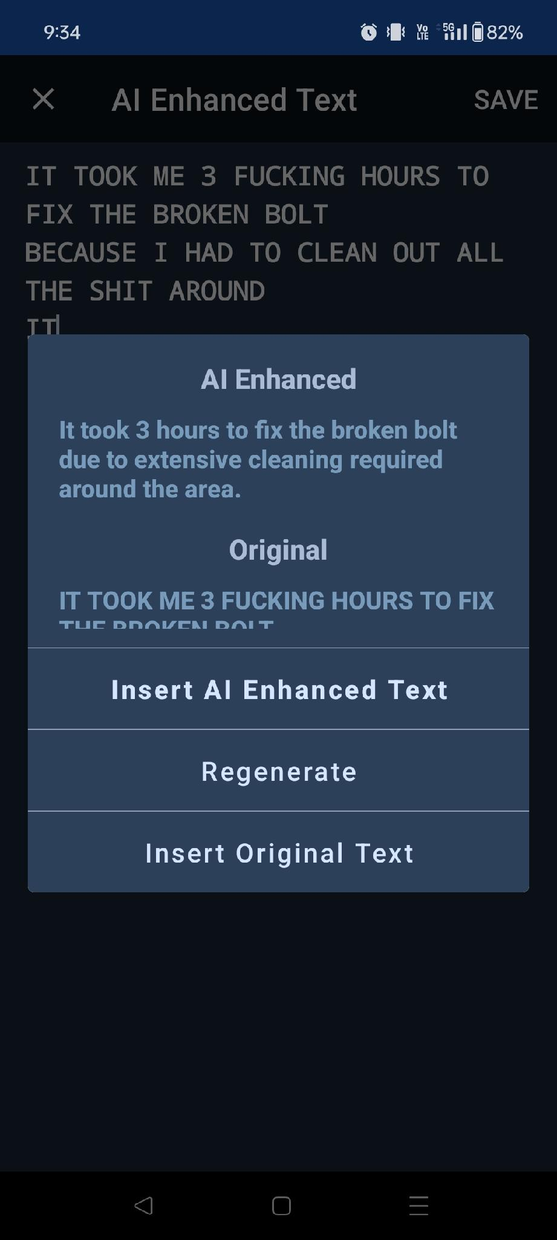

Slide 38
The AI Enhance feature cleaned up the text and removed any foul wording.

Slide 39
All 3 of these examples were generated using the “speak to text” function of an Android keyboard.

